Slide 1
The Truth About Solar Benefits For the Commonwealth
Massachusetts Economic Development Council
June 17, 2016

Slide 2
GROWING OUR SOLAR-POWERED ECONOMY
Who is MassSolar?
MassSolar is a non-profit organization representing Massachusetts solar businesses, solar owners, environmental advocates, community organizations and motivated citizens. We are dedicated to:
Supporting the continued growth of the Massachusetts solar economy;
Maximizing solar energy’s potential as a solution to climate change;
Modernizing the electricity grid; and
Ensuring that everyone has fair and equitable access to affordable solar power.
Some of our affiliated organizations and companies:

Slide 3
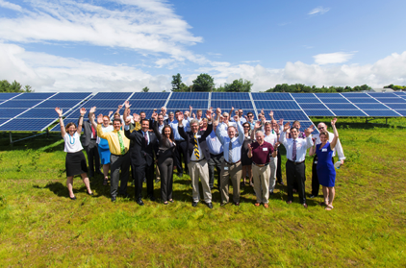
GROWING OUR SOLAR-POWERED ECONOMY
Solar is Working for Massachusetts
Solar is delivering a wide range of economic, environmental and social benefits
to Massachusetts communities and ratepayers
$1 invested in solar yields $2.20 to $2.70
in benefits (Source: Net Metering and Solar Task Force)
Solar supports almost 15,000 jobs
36,000+ solar systems installed
Solar provides long-term stable, predictable energy costs for Massachusetts businesses, protecting jobs

Slide 4
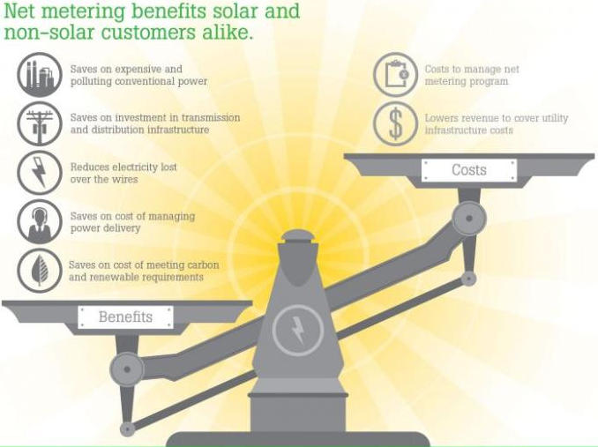
GROWING OUR SOLAR-POWERED ECONOMY
Solar benefits all ratepayers, not just those with solar
The Commonwealth at-large receives a total of $10.2 billion in net benefits from solar compared to net costs of $4.5 billion (Source: NMSTF report, pg 195)
Notes:
Diversifies energy resources and mitigates fossil fuel price volatility
Generates energy close to source, avoiding transmission line loss and need to pay for “wasted” energy
Can avoid need for costly transmission lines and distribution upgrades
Zero emission source of energy helping to meet GWSA targets

Slide 5
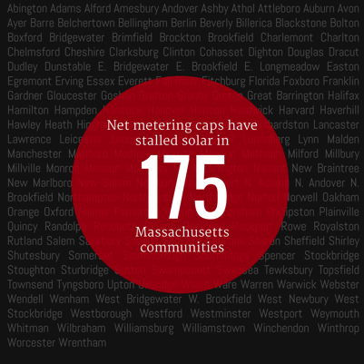
GROWING OUR SOLAR-POWERED ECONOMY
GROWING OUR SOLAR-POWERED ECONOMY
Vocabulary
Solar Power is Stalled in Massachusetts
1. Net Metering- Allows solar customers to run their meters backwards and receive credit for excess solar generation. Key mechanism for encouraging development of solar.
2. Virtual Net Metering (VNM)- Allows solar owners to share net metering credits with more than one utility account. Enables equal access to solar for everyone.
3. Community Shared Solar (CSS)- A local solar project where people or businesses purchase net metering credits or a membership interest. Makes solar available to those that don’t own a sunny rooftop.
4. Net Metering Caps- Statutory limit on net metering, divided by utility territory, and further divided into “public” and “private” caps, % cap translated into MW-limit based on peak demand
5. Federal Investment Tax Credit (ITC)- 30% tax credit for solar systems. Expires December 31, 2016 for residential solar, decreases to 10% for commercial solar.
6.
Why?
Solar projects on hold for over a year in 175 communities (Note: small solar exempted)
43 MW of Solar projects currently on hold
Over $100 million of projects on hold
Net Metering rates cut for low-income and Community Shared Solar
SREC II program closed for 2017 projects.
SREC III rates are uncertain.
Undefined Minimum Charges
Caps hit in National Grid territories

Slide 6
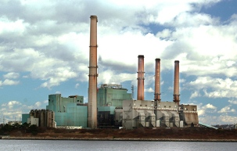
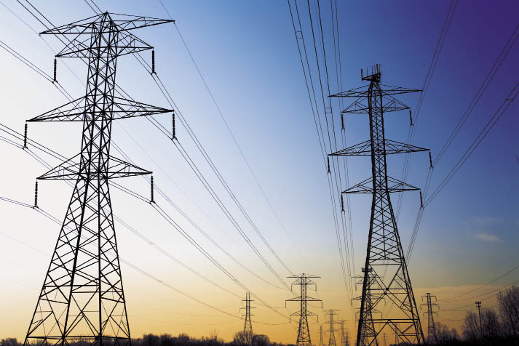
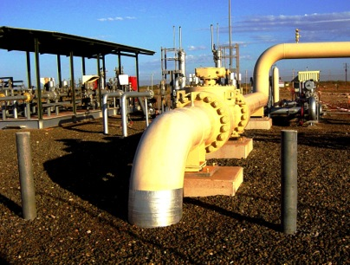
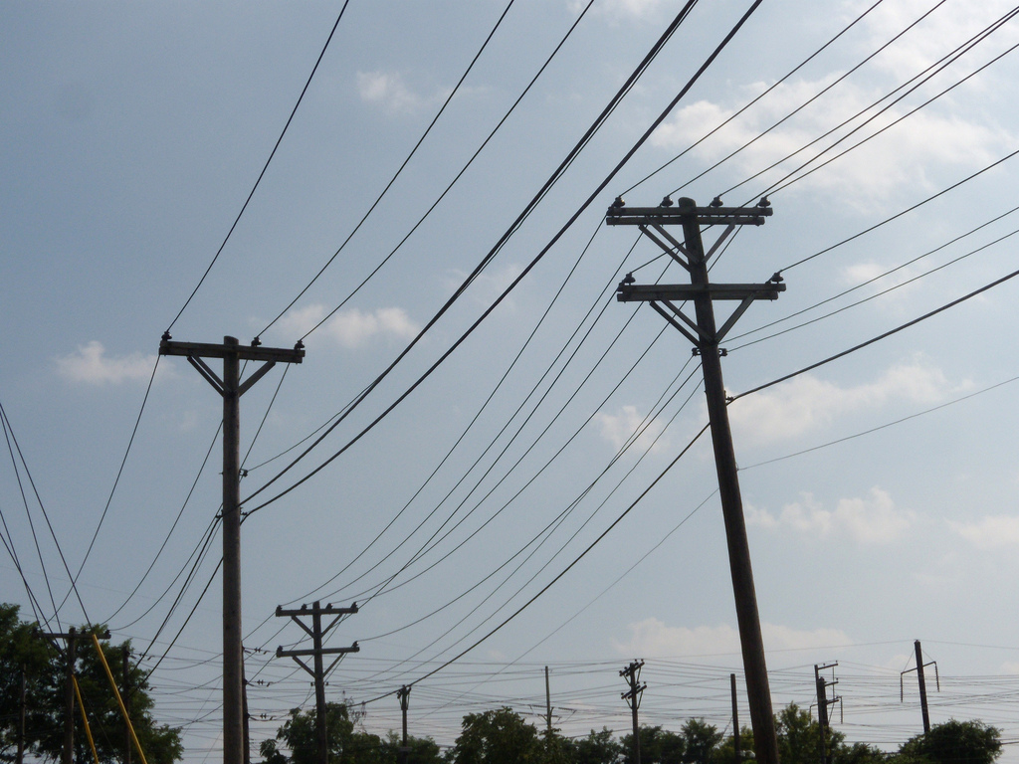
GROWING OUR SOLAR-POWERED ECONOMY
Utility Business Model in Massachusetts
Earns guaranteed rate of return for building reliable infrastructure
Shareholder value highly dependent on increasing demand
Generation
Transmission / Pipelines
Distribution
Power generators
Investor Owned Utilities
Notes:
When we started building the electricity grid over a century ago, our primary goals were to provide reliable access to electricity for everyone in the country. This required a massive capital investment to build central power plants and the transmission and distribution lines to connect customers to those central power plants.
We didn’t want to pay for those investments twice, so we granted our utilities a monopoly. And because we didn’t want utilities to shy away from investing in building out the grid even in remote rural locations – we guaranteed them a fixed rate of return for all of their investments.
We still have basically the same incentive structure in place today. So now – let me ask you a question. If you had a monopoly and you were guaranteed to make more money the more money you spent – what would you do?

Slide 7
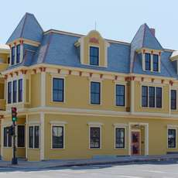
GROWING OUR SOLAR-POWERED ECONOMY
Solar is working for low income communities
Community Action for Better Housing, pays electricity bills to keep costs affordable for low income tenants
Annual electricity bill $5,500, jumped 28% last winter
Rooftop not suitable for solar
With off-site solar subscription, saving $1,200 a year, electricity costs now stable
Oscar Romero House, New Bedford
12 units of affordable housing

Slide 8
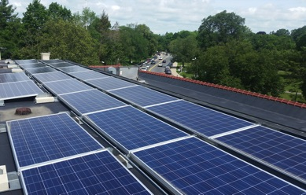
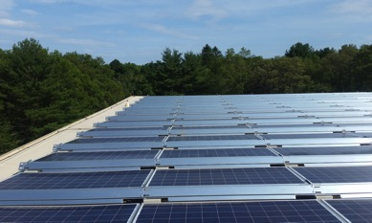
GROWING OUR SOLAR-POWERED ECONOMY
Solar is working for cities and towns
Lexington’s 1.1 MW Solar Rooftop Project
5 Schools and Town Library
$5.6 million savings over 25 years
$800,000 in health benefits
1.3 million kWh insulated from
winter energy price spikes
Provides 15% municipal electricity demand,
enough to power 175 homes

Slide 9
GROWING OUR SOLAR-POWERED ECONOMY
Community shared solar allows everyone solar access
300 kW locally owned community solar in Pioneer Valley
8 in 10 residents in Massachusetts cannot put solar on their roof
Local residents own a share of the system and receive ALL tax credit benefits
Participants expected to save $600,000 on electricity bills over 20 years

Slide 10
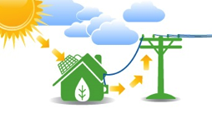
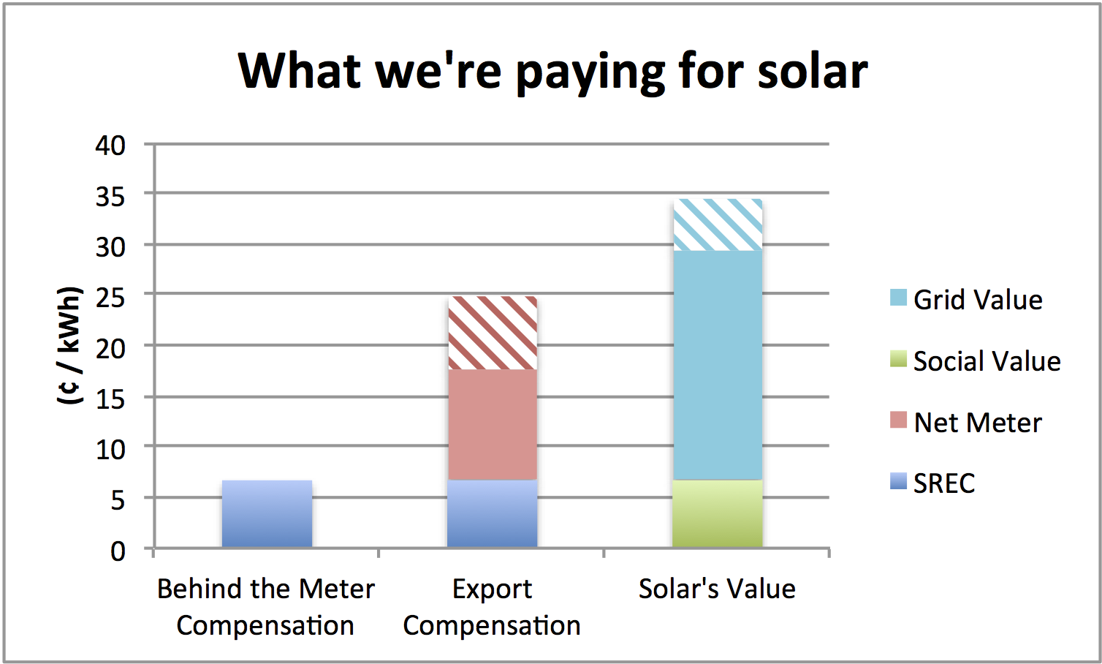
GROWING OUR SOLAR-POWERED ECONOMY
Solar Compensation in Massachusetts
Solar owners receive between 6 - 24 ¢ / kWh, depending on system type and utility rate class
$0.18¢/kWh
$0.06 ¢/kWh
vs. value of solar
SREC II compensation is
6 ¢ / kWh averaged over expected life of system
Onsite consumption receives zero net metering credits
Exported power receives net meter credits 12-18 ¢ / kWh
Value of solar is 29-34 ¢ / kWh including societal values of 6.7 ¢/kWh
Notes:
Solar consumed on-site has zero net metering costs
SRECs last for 10 years and solar system last for at least 30 yrs
Current SREC II’s costs 25 cents/kWh, averaged over 30 yrs, the SREC cost is 7 cents/ kWh
Value of solar to grid estimated to 22-28 cents/kWh with additional societal values of 6.7 cents/kWh

Slide 11
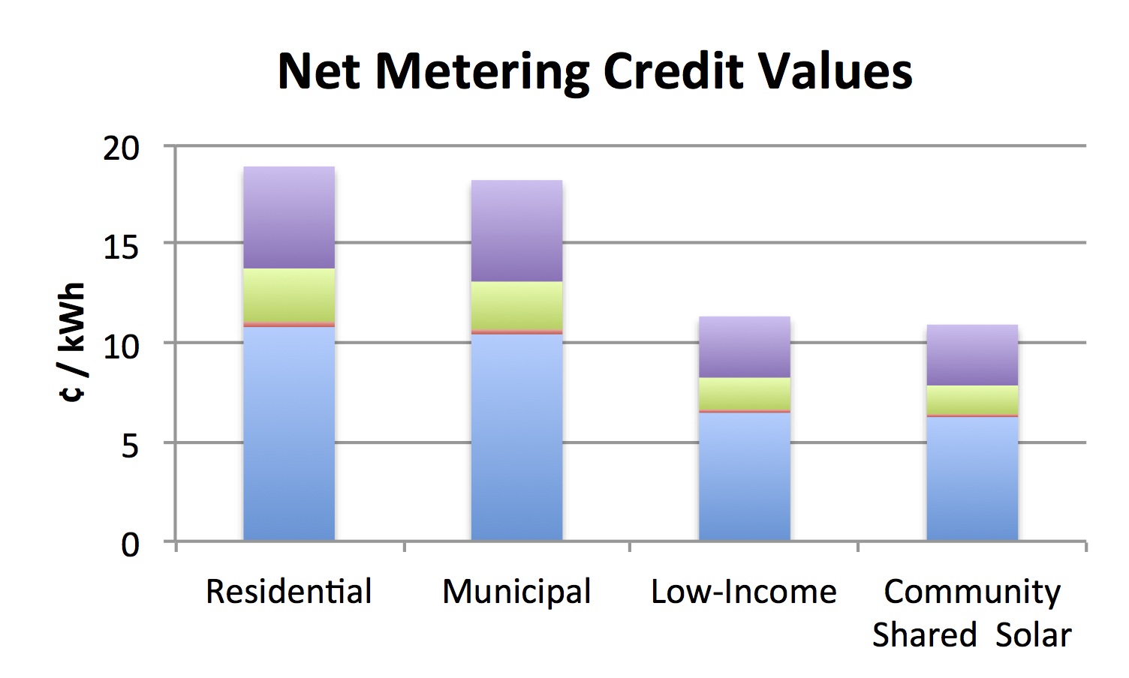
GROWING OUR SOLAR-POWERED ECONOMY
Fair compensation for net metering is critical
Recent legislation arbitrarily cut net metering credit values 40% for low-income and community shared solar
NO consideration of solar’s benefits
NO consideration of project economic viability
Proposals reduce solar access for low income, renters and those who do not own sunny rooftops

Slide 12
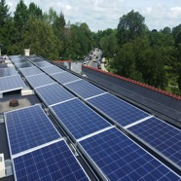
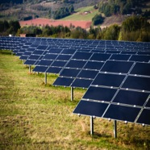
GROWING OUR SOLAR-POWERED ECONOMY
Rate cuts kill projects & transfers benefits to utilities
Low income
Municipal
Community shared
Oscar Romero House
Previous savings: $1,200 / yr
Net metering cut: -$ 480 / yr
Minimum charge: -$ 840 / yr
SREC III cut*: -$2,400 / yr
Total -$2,520 / yr
Lexington
Previous savings: $ 89,200 / yr
Minimum charge: -$ 36,960 / yr
SREC III cut*: -$105,600 / yr
Total -$53,360 / yr
Pioneer Valley
Previous savings: $30,000 / yr
Net metering cut: -$12,000 / yr
Minimum charge: -$10,080 / yr
SREC III cut*: -$28,800 / yr
Total -$20,880 / yr
*Assumes SREC III rates are 40% less than SREC II rates
Notes:
National Grid has proposed minimum charges as part of their current rate case being considered by the DPU.
The real effect of this legislation is that it transfers $480 in net meter credits + $840 in minimum charges that were previously benefiting low-income people to the utility.
That is a $1,320 a year cost shift or transfer.
And that is before any SREC III rate change.
Legislation that was supposedly adopted to protect low-income folks – actually ends up leaving them dramatically worse off than they were before.

Slide 13
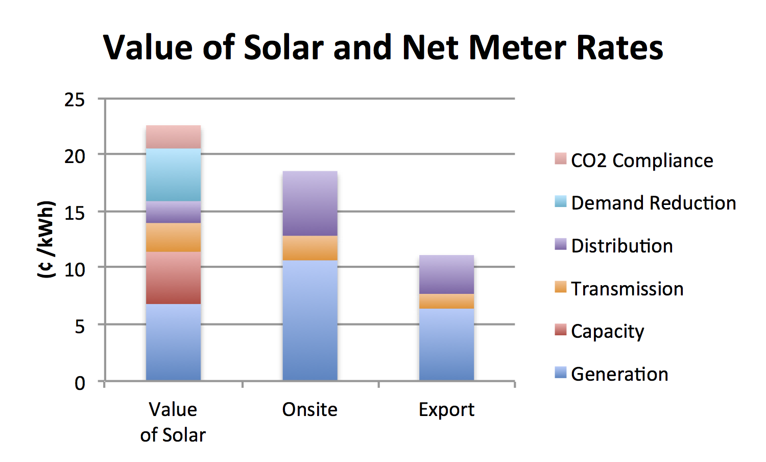
GROWING OUR SOLAR-POWERED ECONOMY
1 kWh Solar Energy is worth more than 1 kWh Fossil Fuel Energy
Solar electricity is worth MORE THAN retail rates
15,000 local jobs, cleaner air, cleaner water, lower health care costs
Reduces need for power plants, transmission lines and pipelines
Lowers energy price volatility and reduces greenhouse gas emissions
Acadia Center study shows the grid value of solar ranges from 22-28 cents/kWh
Notes:
Need to work on argumentation for this slide

Slide 14
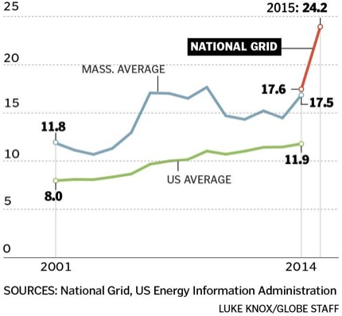
What are our costs if we stop investing in solar?
We could continue with the status quo
Doubling down on natural gas
Winter rates went from 17 cents / kWh to 24 cents / kWh
Winter rate increase that cost ratepayers $3.5 billion a year for past two years
National Grid Electricity Costs ¢ / kWh

Slide 15
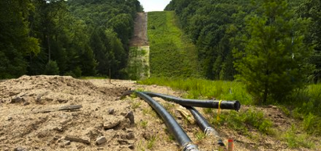
What will it cost if we stop investing in solar?
We could build pipelines
Eversource proposed $3 billion in new pipelines
National Grid proposed $8 billion in new pipelines – Now Cancelled
Pipelines the Attorney General says we don’t need
Pipelines that will connect our natural gas to the world market
Electricity rates will rise when natural gas prices rise to world market

Slide 16
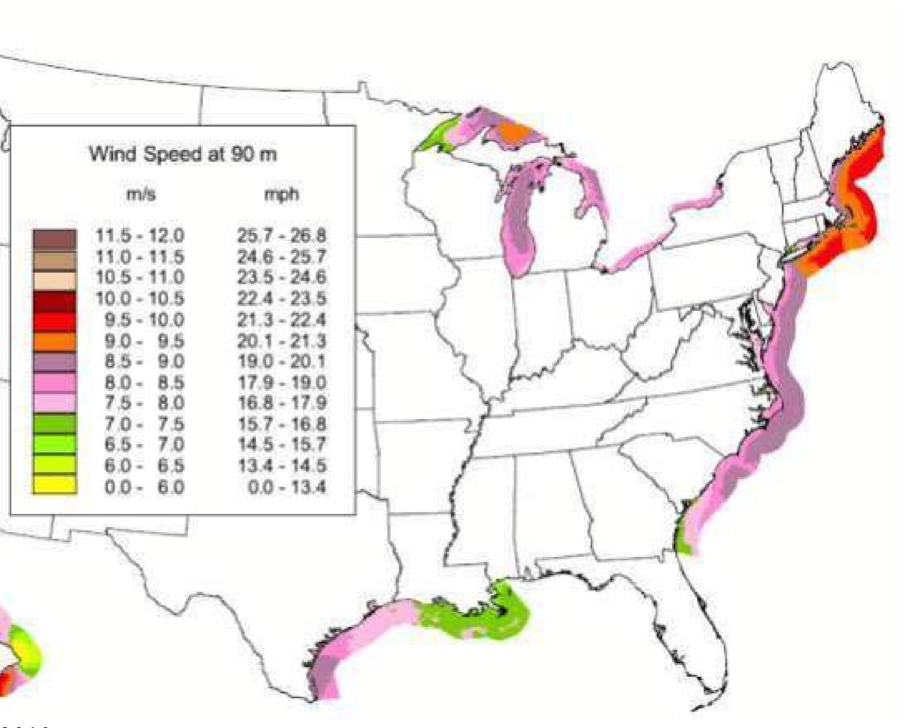
What happens if we stop investing in solar?
We could switch to Offshore Wind
No greenhouse gas emissions
Tremendous Potential - Massachusetts is the Saudi Arabia of Wind
Will produce local jobs
But offshore wind generation costs are 1.5x to 2x solar costs per kWh
Offshore wind projects will take 5 or 6 years to come online – once approved
And will require transmission lines

Slide 17
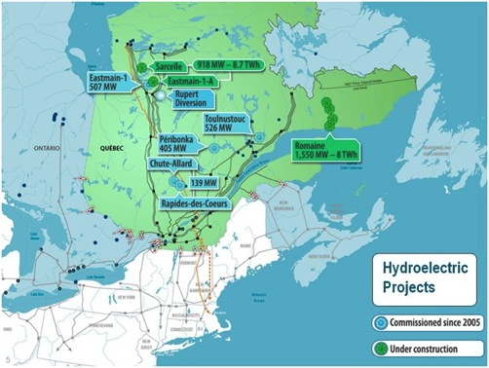
What are our options if we stop investing in solar?
We could switch to Hydro Quebec
Gov. Baker assumes buying hydro results in no greenhouse gas emissions
But Hydro Quebec’s own research contradicts this assumption
Newly inundated reservoir has equivalent greenhouse gas emissions comparable to natural gas plant for 10 years after flooding
70% of natural gas power plant greenhouse gas emissions over 20 years

Slide 19
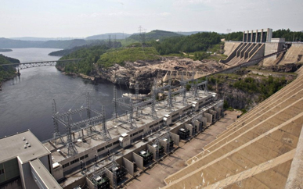
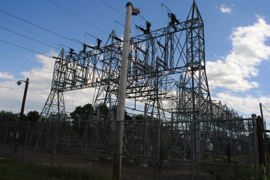
What will it cost us if we stop investing in solar
We could spend $7.6 billion on transmission lines
$1.4 billion on Northern Pass
$1.2 billion on NE Clean Power
$2 billion on Champlain Hudson
$1 billion on Maine Green Line
$2 billion on Northeast Energy Link
Last 11 Eversource and National Grid transmission line projects expected to cost $2.2 billion – final cost $3.9 billion
Notes:
If cost overruns continue based on past history - $7.6 billion estimate could easily rise to $13.5 billion.

Slide 20
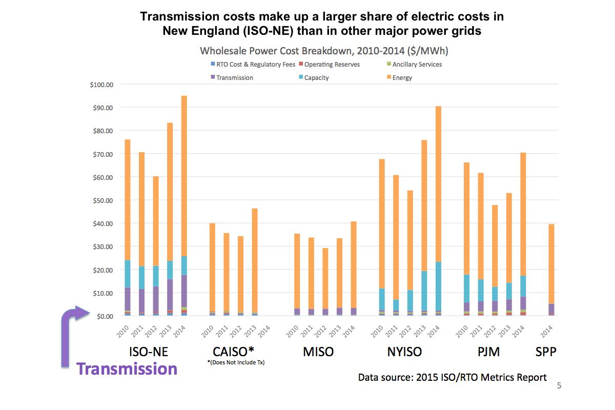
ISO-NE Transmission Costs Double 2nd highest region

Slide 21
FERC investigating ISO-NE Transmission Costs
FERC Order Instituting Section 206 Proceeding
We find that:
ISO-NE Transmission tariff and rates appear to be “unjust, unreasonable, unduly discriminatory or preferential, or otherwise unlawful.”

Slide 22
GROWING OUR SOLAR-POWERED ECONOMY
Ask your Legislator to support good solar policy
Consider benefits of solar as well as the costs
Net Metering and Solar Task Force report shows every $1 invested in solar yields $2.20-$2.70 in benefits
Solar benefits ALL ratepayers by lowering energy supply prices, diversifies our energy portfolio, avoiding need for investment in new infrastructure, generating power more efficiently, avoiding air pollution
Solar creates jobs, builds healthier communities and expands tax bases
Solar programs involve NO risk to ratepayers, i.e. solar only gets paid when it works, and encourages private capital to invest in new local generation, which is badly needed

Slide 23
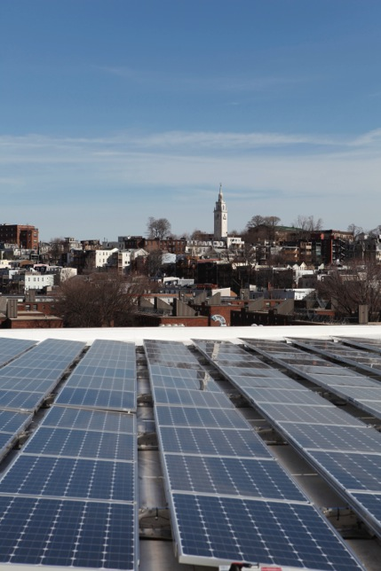
GROWING OUR SOLAR-POWERED ECONOMY
Good solar policy
Retain Retail Net Metering Rates
Implement SREC III program immediately
Grandfather existing projects
No New Charges
Eliminate net metering caps
A sustainable, stable solar market cannot survive while caps constrain growth and unpredictable policies create a stop-and-start dynamic in the market

Slide 24
GROWING OUR SOLAR-POWERED ECONOMY
Questions?

Slide 25
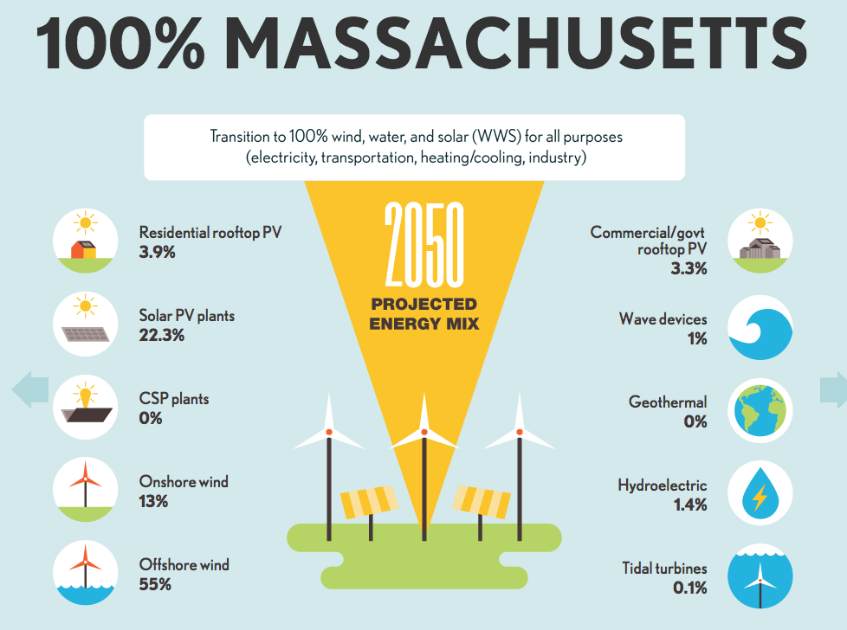
GROWING OUR SOLAR-POWERED ECONOMY

Slide 26
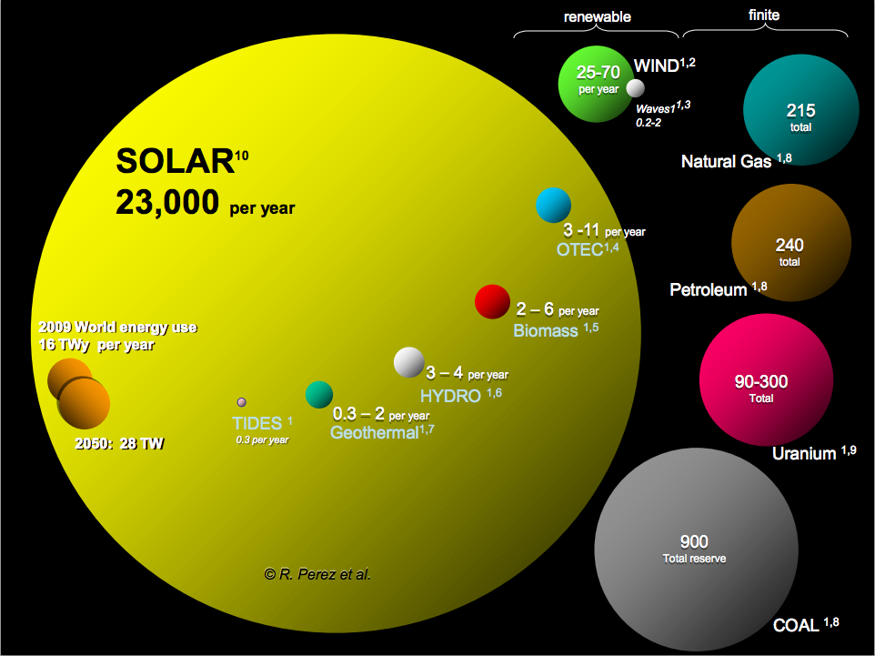
Solar Energy Potential
70 to 170 years of finite energy reserves
Its time to move to renewable energy sources

Slide 27
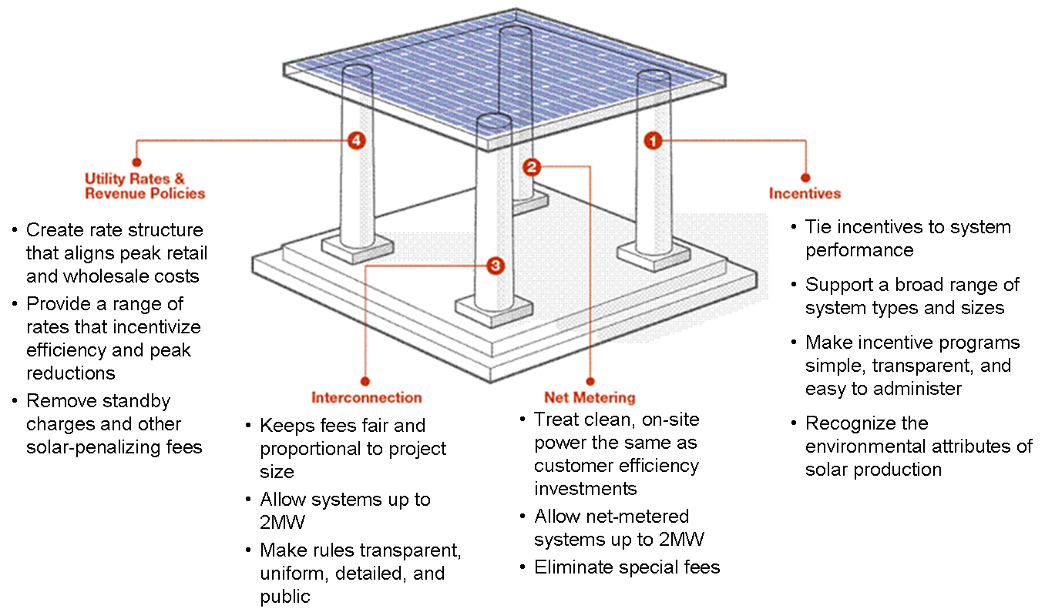
Four Pillars of Solar Policy

Slide 28
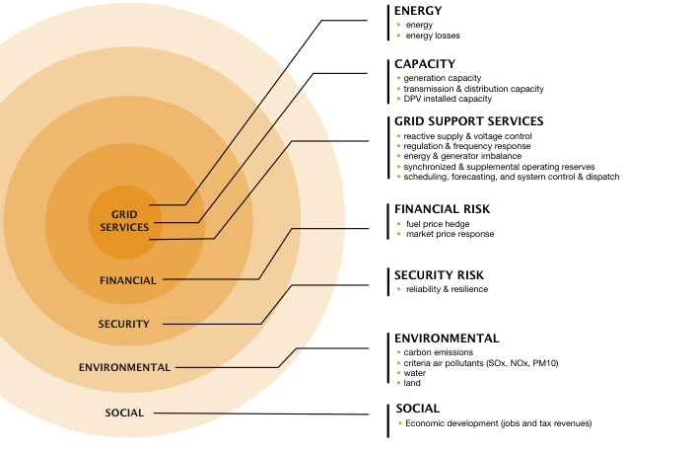
Seven Circles of Solar Value

Slide 29
Vocabulary
1. Net Metering- Allows solar owners to receive compensation for solar generation. Key mechanism for encouraging development of solar.
2. Net Metering Caps- Statutory limit on the amount of net metering allowed in each utility territory, based on peak demand.
3. Virtual Net Metering (VNM)- Allows solar owners to share net metering credits with more than one utility account. Enables equal access to solar for everyone.
4. Community Shared Solar (CSS)- Makes solar available to those that don’t own a sunny rooftop. A local solar project that shares net metering credits with members.
5. SREC – Solar Renewable Energy Certificate. Incentive for producing 1 MWh of solar electricity.

Slide 30
GROWING OUR SOLAR-POWERED ECONOMY
GROWING OUR SOLAR-POWERED ECONOMY
Solar Compensation in MA
Vocabulary
1. Net Metering- Allows solar customers to run their meters backwards and receive credit for excess solar generation. Key mechanism for encouraging development of solar.
2. Virtual Net Metering (VNM)- Allows solar owners to share net metering credits with more than one utility account. Enables equal access to solar for everyone.
3. Community Shared Solar (CSS)- A local solar project where people or businesses purchase net metering credits or a membership interest. Makes solar available to those that don’t own a sunny rooftop.
4. Net Metering Caps- Statutory limit on net metering, divided by utility territory, and further divided into “public” and “private” caps, % cap translated into MW-limit based on peak demand
5. Federal Investment Tax Credit (ITC)- 30% tax credit for solar systems. Expires December 31, 2016 for residential solar, decreases to 10% for commercial solar.
6.
Net metering
Compensation for every kWh of electricity delivered to grid; NOT a subsidy
Payment in the form of a credit on a utility electricity account
Net metering “capped” by legislature for projects over a certain size
Solar Incentive – Solar Renewable Energy Certificates (SRECs)
Incentive for delivering environmental and societal benefits
Designed to support goal of 1600 MW; no capacity remaining
1 MWh of solar electricity equals 1 SREC. Value of SREC depends on SREC factor.
Taxable income, if the SREC is sold to another party

