Slide 1
How Solar Energy Benefits Communities Across the Commonwealth
Legislative Briefing
January 14, 2016

Slide 2
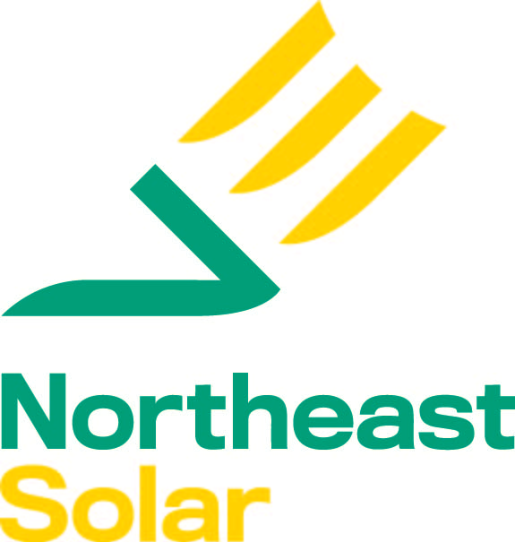
GROWING OUR SOLAR-POWERED ECONOMY
Who is MassSolar?
MassSolar is Working, Inc. is a collaboration of Massachusetts solar businesses, solar owners, environmental advocates, community organizations and motivated citizens. We are dedicated to:
Supporting the continued growth of the Massachusetts solar economy;
Modernizing the electricity grid;
Maximizing the potential of solar as a solution to climate change; and
Ensuring that everyone has fair and equitable access to affordable solar power.
Some of our affiliated organizations and companies:

Slide 3
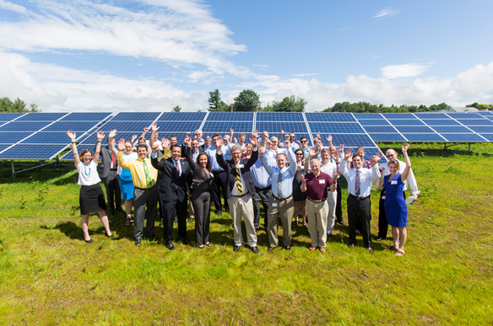
GROWING OUR SOLAR-POWERED ECONOMY
Solar is working for Massachusetts
Solar is delivering a range of economic, environmental and social benefits to Massachusetts communities and ratepayers
$1 invested in solar yields $2.20 to $2.70
in benefits (Source: Net Metering and Solar Task Force)
Solar supports almost 15,000 jobs
36,000+ solar systems installed
Solar provides long-term stable, predictable energy costs for Massachusetts businesses, protecting jobs

Slide 4
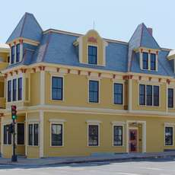
GROWING OUR SOLAR-POWERED ECONOMY
Solar is working for low income communities
Community Action for Better Housing owned, pays electricity bills to keep costs affordable for low income tenants
Annual electricity bill $5,500, jumped 28% last winter
Rooftop not suitable for solar
With off-site solar subscription, saving $1,200 a year, electricity costs now stable
Oscar Romero House, New Bedford
12 units of affordable housing

Slide 5
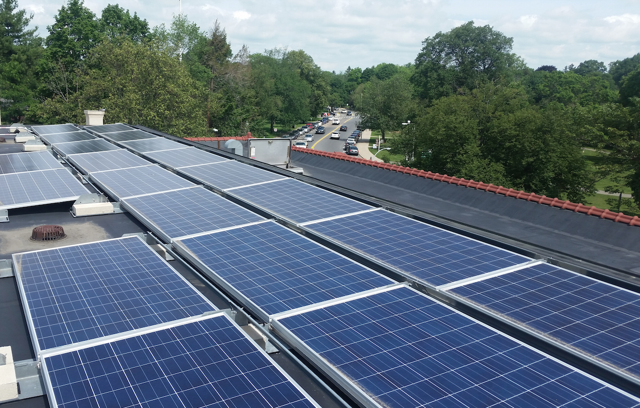
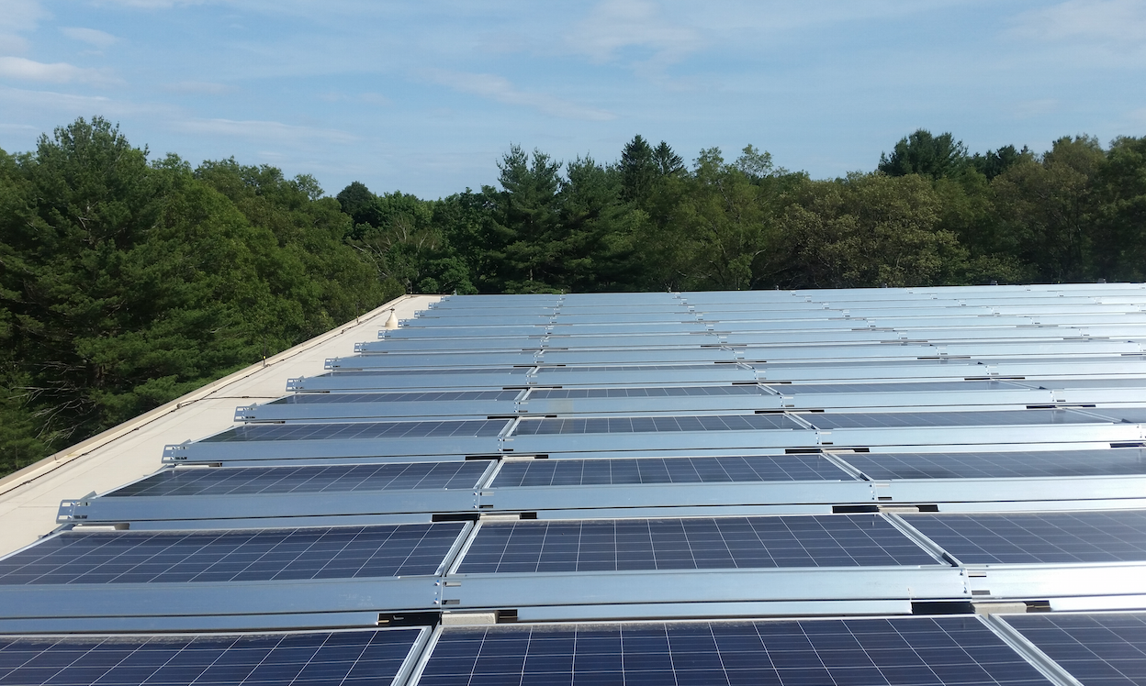
GROWING OUR SOLAR-POWERED ECONOMY
Solar is working for cities and towns
Lexington’s 1.1 MW Solar Rooftop Project
5 Schools and Town Library
$5.6 million savings over 25 years
$800,000 in health benefits
1.3 million kWh insulated from
winter energy price spikes
Provides 15% municipal electricity demand,
enough to power 175 homes

Slide 6
GROWING OUR SOLAR-POWERED ECONOMY
Community shared solar (CSS) allows everyone access to solar
300 kW locally owned community solar in Pioneer Valley
8 in 10 residents in Massachusetts cannot put solar on their roof
Local residents own a share of the system and receive ALL tax credit benefits
Participants expected to save $600,000 on electricity bills over 20 years

Slide 7
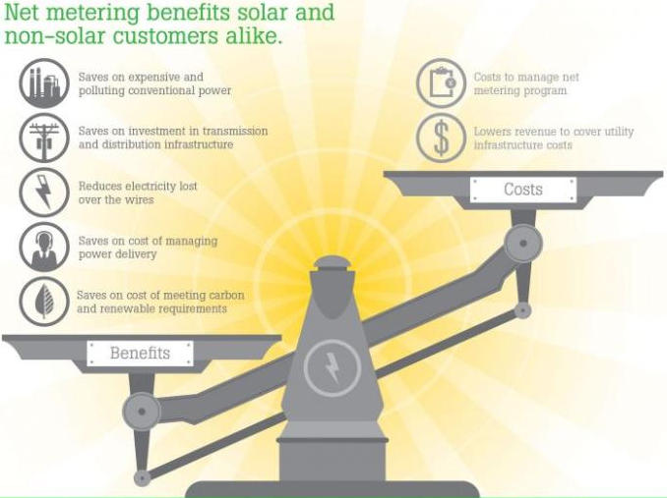
GROWING OUR SOLAR-POWERED ECONOMY
Solar benefits all ratepayers, not just those with solar
The Commonwealth at-large receives a total of $10.2 billion in net benefits from solar compared to net costs of $4.5 billion (Source: NMSTF report, pg 195)
Notes:
Diversifies energy resources and mitigates fossil fuel price volatility
Generates energy close to source, avoiding transmission line loss and need to pay for “wasted” energy
Can avoid need for costly transmission lines and distribution upgrades
Zero emission source of energy helping to meet GWSA targets

Slide 8
GROWING OUR SOLAR-POWERED ECONOMY
GROWING OUR SOLAR-POWERED ECONOMY
Vocabulary
Before diving in: Solar policy mini-primer
1. Net Metering- Allows solar customers to run their meters backwards and receive credit for excess solar generation. Key mechanism for encouraging development of solar.
2. Virtual Net Metering (VNM)- Allows solar owners to share net metering credits with more than one utility account. Enables equal access to solar for everyone.
3. Community Shared Solar (CSS)- A local solar project where people or businesses purchase net metering credits or a membership interest. Makes solar available to those that don’t own a sunny rooftop.
4. Net Metering Caps- Statutory limit on net metering, divided by utility territory, and further divided into “public” and “private” caps, % cap translated into MW-limit based on peak demand
5. Federal Investment Tax Credit (ITC)- 30% tax credit for solar systems. Expires December 31, 2016 for residential solar, decreases to 10% for commercial solar.
6.
Net metering
Net metering credits compensate solar owners for every kWh electricity delivered to grid; NOT a subsidy
Payment in the form of a credit on a utility electricity account
Net metering “capped” by statute for projects over a certain size
Accounting mechanism administered by the Department of Public Utilities
Solar Incentive
Compensates solar for environmental and societal benefits
Designed to manage the growth of solar to 1600 MW; limited capacity remaining
1 MWh of solar electricity equals 1 SREC. Value of SREC depends on SREC factor.
Payment as cash (i.e. taxable income), if the SREC is sold to another party
SREC II administered by the Department of Energy Resources
Notes:
Taking a step back slide before diving into why the bills are going to kill the solar projects.

Slide 9
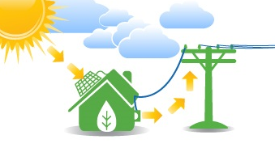
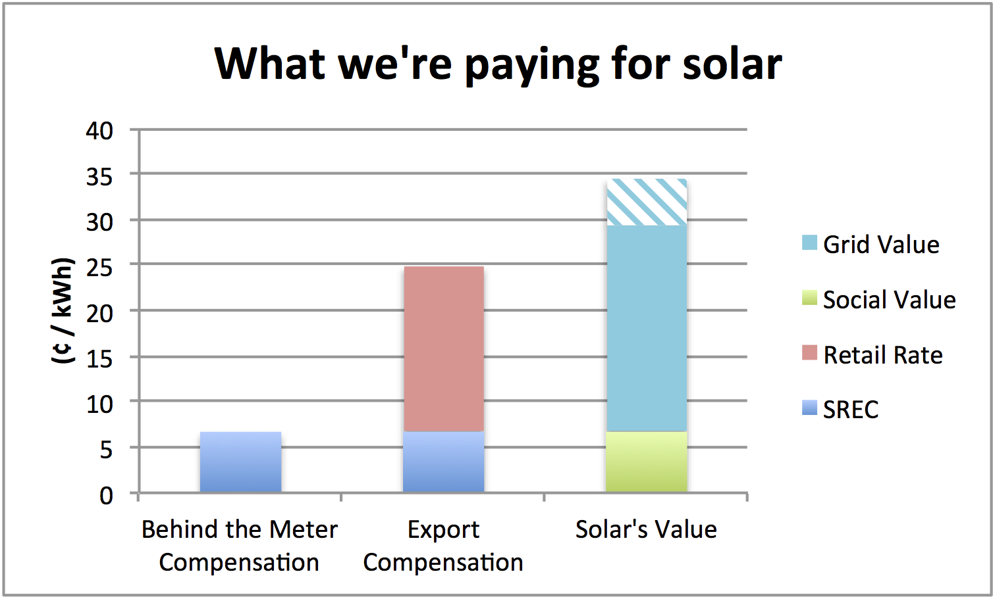
GROWING OUR SOLAR-POWERED ECONOMY
What are we really paying for solar?
Governor Baker claims that solar receives 43 ¢/kWh
In reality, solar owners receive between7-25 ¢/kWh, depending on system type and utility rate class
0.07
0.18
Current SREC II compensation is 7 ¢/ kWh averaged over expected life of system
Onsite consumption receives zero net metering credits
Exported power receives retail net meter credits ~18 ¢/ kWh
Value of solar is 29-34 ¢/kWh including societal values of 6.7 ¢/kWh
vs. value of solar
Notes:
Solar consumed on-site has zero net metering costs
SRECs last for 10 years and solar system last for at least 30 yrs
Current SREC II’s costs 25 cents/kWh, averaged over 30 yrs, the SREC cost is 7 cents/ kWh
Value of solar to grid estimated to 22-28 cents/kWh with additional societal values of 6.7 cents/kWh

Slide 10
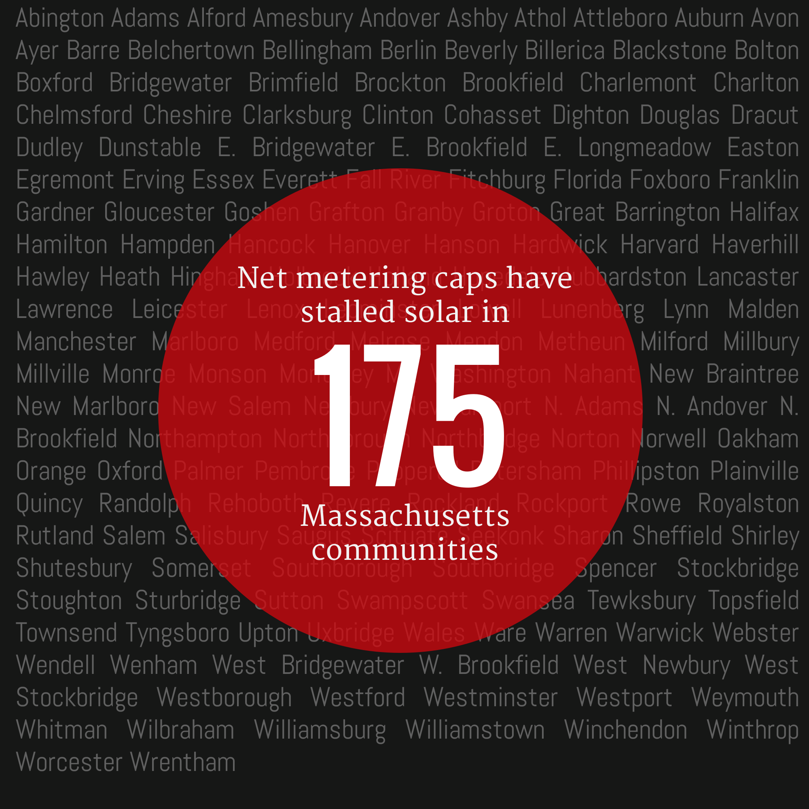
GROWING OUR SOLAR-POWERED ECONOMY
GROWING OUR SOLAR-POWERED ECONOMY
Vocabulary
Solar policy reform on the table
1. Net Metering- Allows solar customers to run their meters backwards and receive credit for excess solar generation. Key mechanism for encouraging development of solar.
2. Virtual Net Metering (VNM)- Allows solar owners to share net metering credits with more than one utility account. Enables equal access to solar for everyone.
3. Community Shared Solar (CSS)- A local solar project where people or businesses purchase net metering credits or a membership interest. Makes solar available to those that don’t own a sunny rooftop.
4. Net Metering Caps- Statutory limit on net metering, divided by utility territory, and further divided into “public” and “private” caps, % cap translated into MW-limit based on peak demand
5. Federal Investment Tax Credit (ITC)- 30% tax credit for solar systems. Expires December 31, 2016 for residential solar, decreases to 10% for commercial solar.
6.
Why?
Net metering caps stalling solar across more than half of Massachusetts (Note: small solar exempted from caps)
Over $400 million of projects on hold
Legislation addressing caps includes other solar policy changes.
Downing amendment (S. 1973), Gov.’s bill (H. 3724), Nov. House bill (H. 3854), Nov. Senate bill (S. 2058)
Proposed policy reforms have significant impacts on low income, community solar, and municipal solar projects
Caps have been hit in National Grid &
Unitil territories
Notes:
Taking a step back slide before diving into why the bills are going to kill the solar projects.

Slide 11
There have been four solar bills in recent session, focusing on several policy elements
Policy element | Downing amendment S.1973 | Governor’s bill H.3724 | Nov. House bill H.3854 | Nov. Senate bill S.2058
When introduced: | End of July | August | Just before Thanksgiving | Last day of Fall session
Net metering caps
Net metering (NM) credit value
Minimum bill
Solar incentive program
Grandfathering
The largest differences exist in these three areas. We will go over these today

Slide 12
Impact on low income, community solar, and municipal solar projects
Policy element | Downing amendment S.1973 | Governor’s bill H.3724 | Nov. House bill H.3854 | Nov. Senate bill S.2058
Net metering caps | Lifts caps to 1600 MW, then eliminates caps completely | 2% cap increase, public and private projects

Slide 13
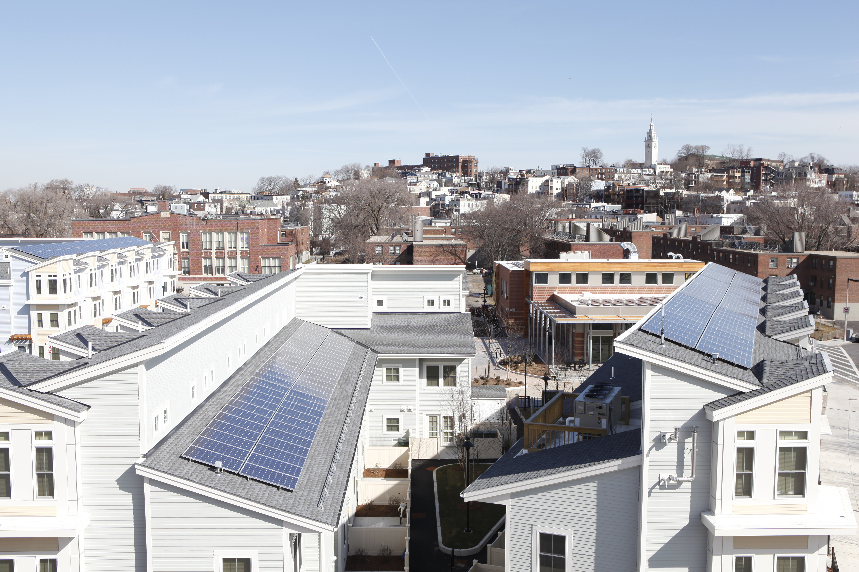
GROWING OUR SOLAR-POWERED ECONOMY
Low income, community solar and municipal solar stalled
2% cap increase solves nothing. These caps will be hit again 3-6 months after being raised.
1% cap increase equals 51 MW in National Grid territory.
52 MW: Public project net metering waiting list
85 MW: Private project net metering waiting list
Old Colony affordable housing solar project in Boston

Slide 14
Impact on low income, community and municipal solar projects
Policy element | Downing amendment S.1973 | Governor’s bill H.3724 | Nov. House bill H.3854 | Nov. Senate bill S.2058
Net metering (NM) credit value | Small solar: Retail NM “Retail lite”: DPU “may” adjust distribution charge for solar exporting more than 1/3 electricity | Small Solar: Retail NM Muni, Low Income, CSS: Basic service All others: Wholesale | Small solar: Retail NM All others: Wholesale | Small solar: Retail NM Muni, Low Income, CSS: Retail lite All others: Basic service
Small Solar: Retail rate

Slide 15
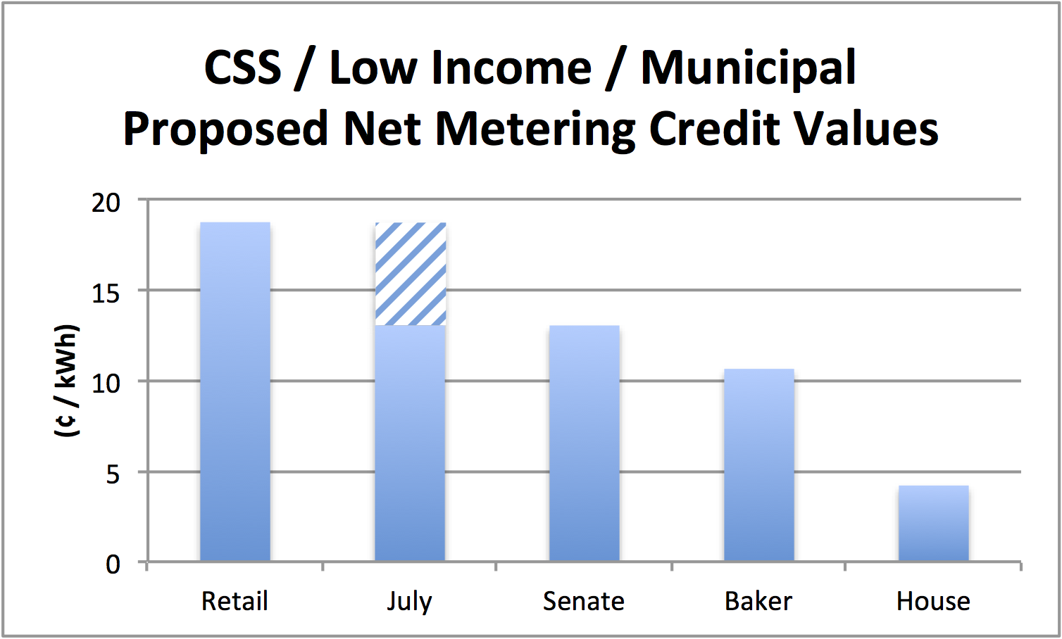
GROWING OUR SOLAR-POWERED ECONOMY
Fair compensation for net metering is critical
Proposed legislation arbitrarily cuts net metering credit values 20%-75%
NO consideration of solar’s benefits
NO consideration of project economic viability
Proposals exacerbate access issues for low income, renters and those without sunny rooftops
Rolls solar policy back to pre-2008, before Global Warming Solutions Act enacted
Senate
Nov
House

Slide 16
GROWING OUR SOLAR-POWERED ECONOMY
Cuts to net metering credits kills projects
Low income
Municipal
Community shared
Oscar Romero House
Current savings: $1,200/yr
Gov. bill savings: $500/yr*
House bill savings: -$2,500/yr
Lexington
Current savings: $73,000/yr
Gov. bill savings: -$31,000/yr
House bill savings: -$116,000/yr
Pioneer Valley
Current savings: $30,000/yr
Gov. bill savings: $5,900/yr
House bill savings: -25,680/yr
Note: Assumes current SREC II incentives, which won’t be available post-1600 MW

Slide 17
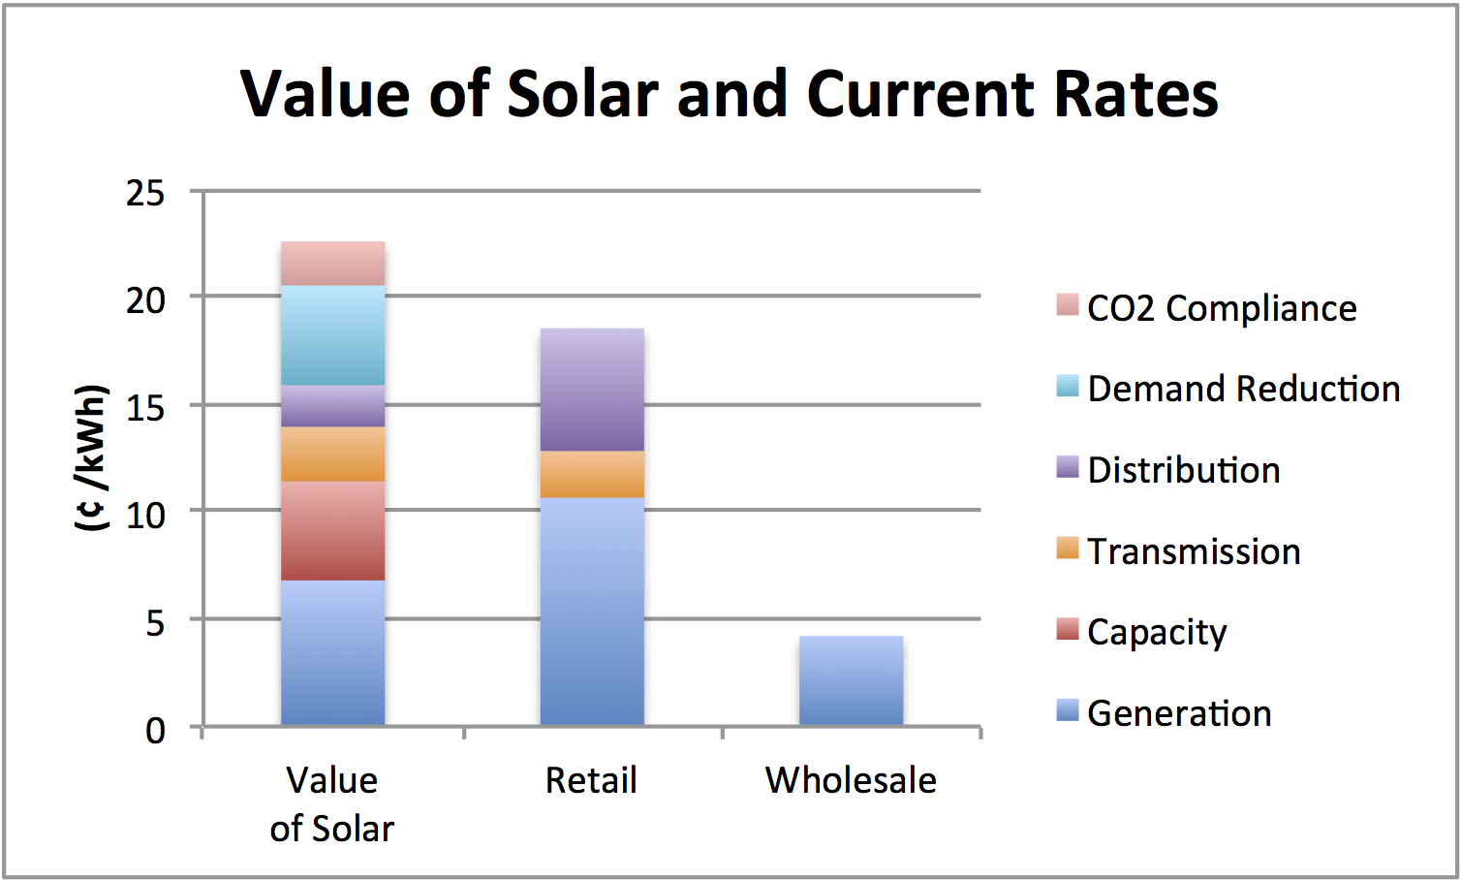
GROWING OUR SOLAR-POWERED ECONOMY
Wholesale isn’t fair payment for solar
Paying solar wholesale rates means paying solar LESS THAN wholesale generators, e.g. natural gas plants, who earn additional revenue from other payments
Studies show solar electricity is worth MORE THAN wholesale and retail rates
Acadia Center study shows the value of solar to the grid ranges from 22-28 cents/kWh
Notes:
Need to work on argumentation for this slide

Slide 18
GROWING OUR SOLAR-POWERED ECONOMY
Offsetting net metering credits with higher incentives is not cost-effective policy
Net metering credits are non-taxable credits, incentives (i.e. SRECs) are taxable cash payments
Large cash payments can create tax problems and undermine opportunity for solar to lower electricity bills
Most new affordable housing developments CANNOT accept cash payments
Could force solar owners to “sell” incentive (i.e. renewable energy attributes) in order to finance system
Every $1 cut in net metering credits requires more than a $1 increase in incentive levels
This approach doesn’t save ratepayers money!
BEST APPROACH:
Maintain current net metering rates and have DOER reduce incentives
Notes:
Update graphic with latest net metering caps
Explain why are net metering caps hit in different rates in different territories.

Slide 19
Impact on low income, community, and municipal solar projects
Policy element | Downing amendment S.1973 | Governor’s bill H.3724 | Nov. House bill H.3854 | Nov. Senate bill S.2058
Minimum bill | None |  | Yes | None

Slide 20
GROWING OUR SOLAR-POWERED ECONOMY
Minimum bills
Language in House bill focuses on “fixed costs”, which will result in highest possible minimum bill
Could mean $360 in annual minimum bills ($30/month) for residential solar customers; much higher bills for everyone else
Low income, municipal and CSS disproportionately impacted because they serve multiple customers and multiple meters
Limited grandfathering for existing projects through 2020
Undermine existing investments and jeopardizes financing
Cuts to net metering credits AND minimum bills will prevent most new solar projects from moving forward- EVEN RESIDENTIAL SOLAR PROJECTS.

Slide 21
GROWING OUR SOLAR-POWERED ECONOMY
Crafting good solar policy:
Lowering costs while maintaining benefits

Slide 22
GROWING OUR SOLAR-POWERED ECONOMY
Crafting good solar policy
Consider benefits of solar as well as the costs
Net Metering and Solar Task Force report shows every $1 invested in solar yields $2.20-$2.70 in benefits
Solar benefits ALL ratepayers by lowering energy supply prices, diversifies our energy portfolio, avoiding need for investment in new infrastructure, generating power more efficiently, avoiding air pollution
Solar creates jobs, builds healthier communities and expands tax bases
Solar programs involve NO risk to ratepayers, i.e. solar only gets paid when it works, and encourages private capital to invest in new local generation, which is badly needed

Slide 23
GROWING OUR SOLAR-POWERED ECONOMY
Crafting good solar policy
2. Avoid arbitrary cuts to net metering credits and minimum bills
Conduct a value of solar study to inform compensation rates or establish a mechanism for solar to pay for use of the grid.
Maintain current net metering framework. Address cost concerns by adjusting incentive levels.
NOTE: Post 1600 MW, new solar projects would receive lower cost renewable energy credits by default
Consider solar costs relative to other energy options on the table, e.g. transmission lines to Canada and new gas pipelines.

Slide 24
GROWING OUR SOLAR-POWERED ECONOMY
Crafting good solar policy
3. Eliminate net metering caps
Net metering caps have been raised by the legislature 4 times since 2008
A sustainable, stable solar market needs cannot be created while caps constrain growth and create a stop-and-start dynamic in the market
Fair compensation for solar plus a mechanism for solar to pay for use of the grid renders net metering caps unnecessary

Slide 25
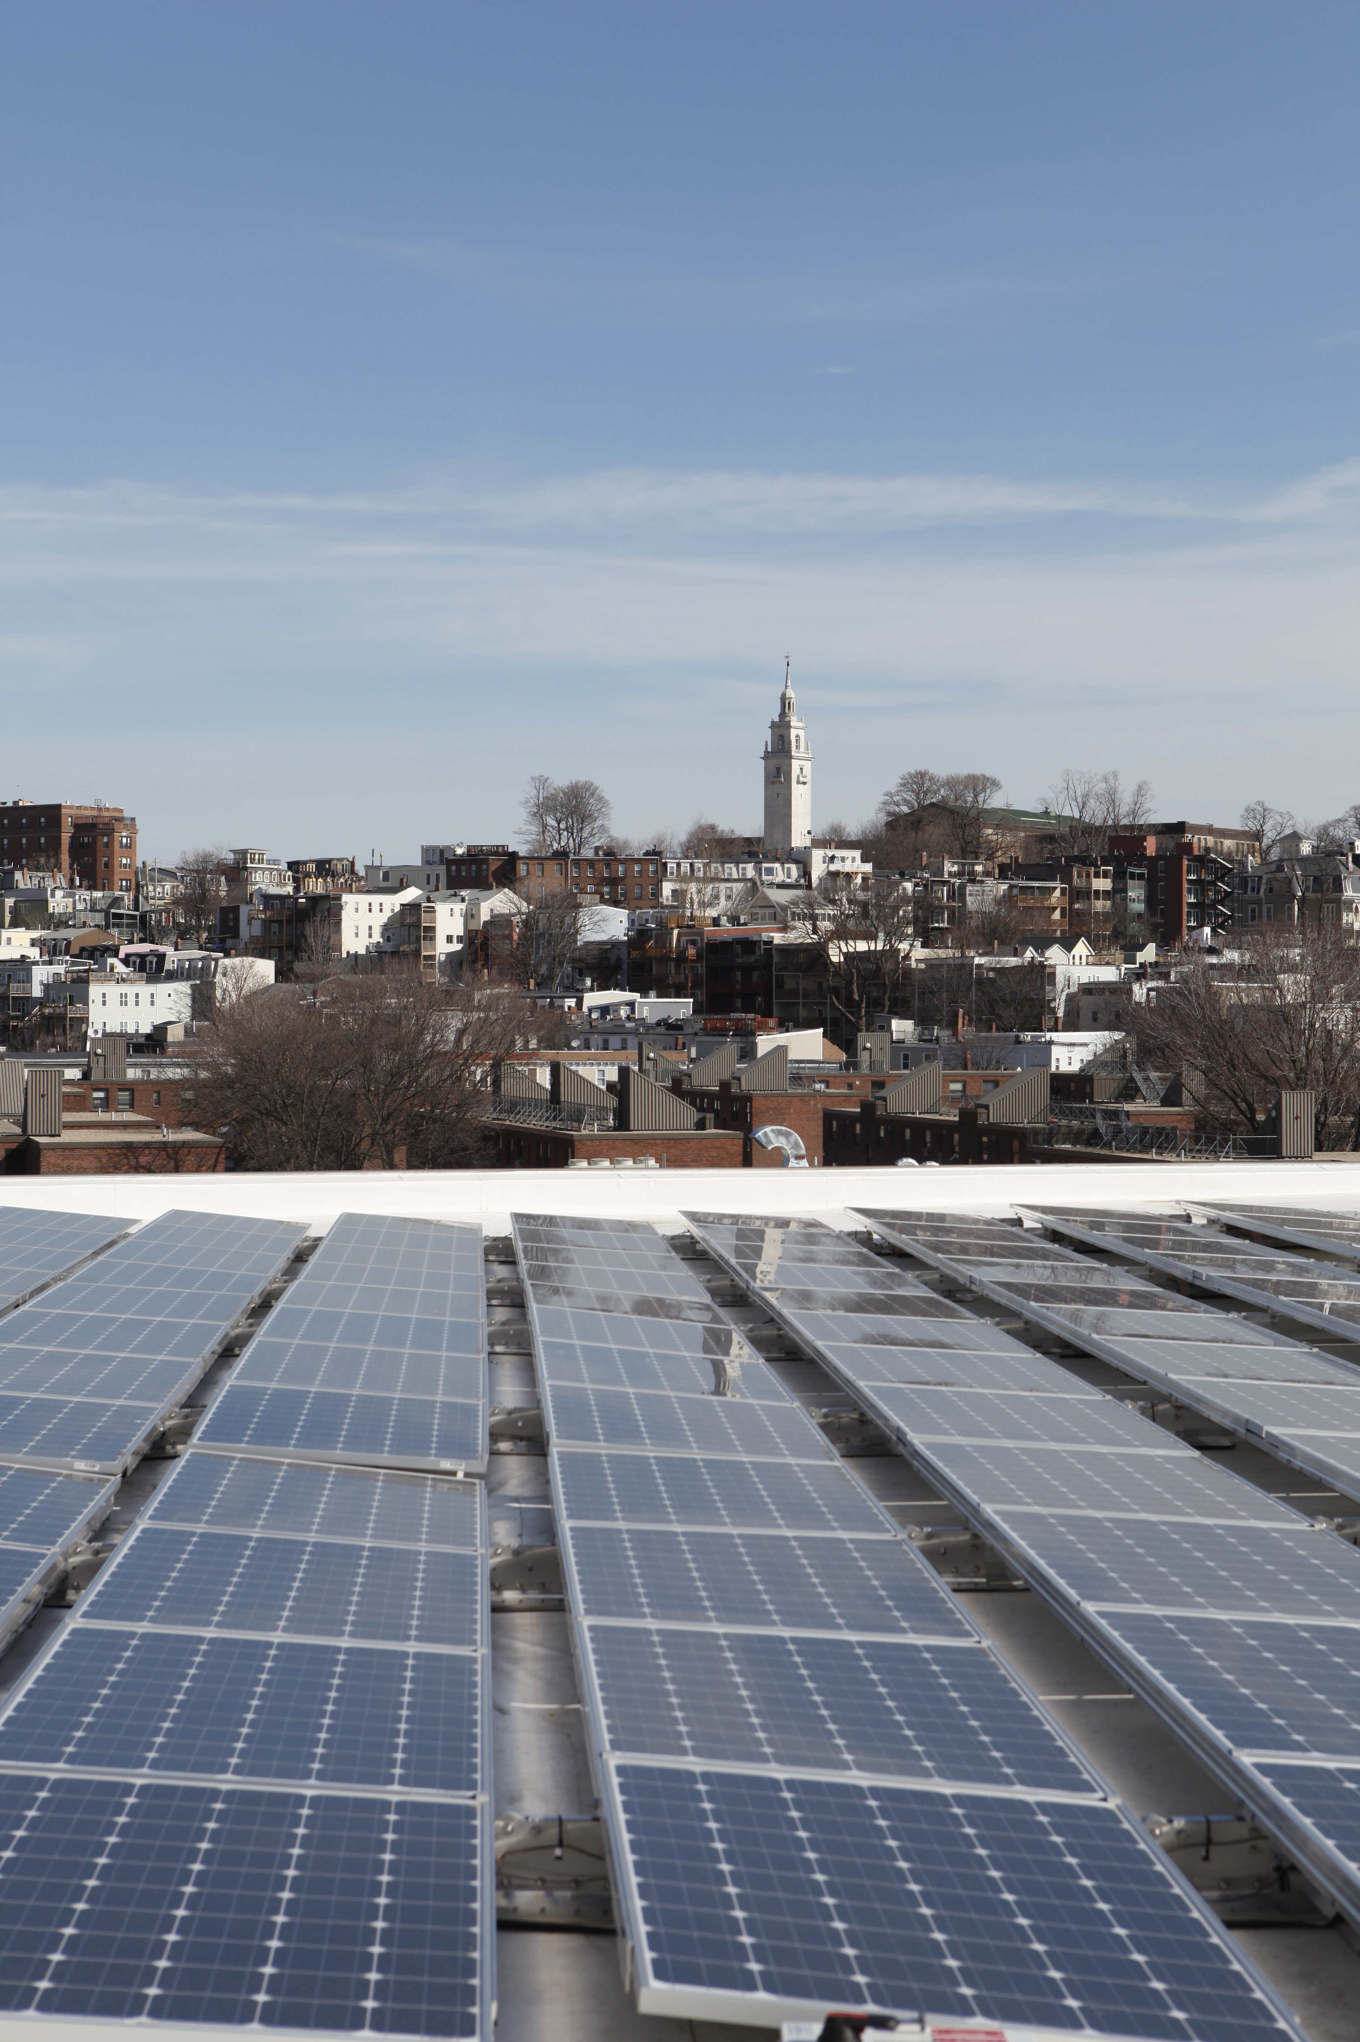
GROWING OUR SOLAR-POWERED ECONOMY
Questions?

